Slide 1


Fall 2023
Michael Boutros, Ian Armada, Shreyas Telkar, Denny Xu, Bharat Mani

Slide 2
The Problem
With the home security market being limited by so few competitors, the cost for home security devices are not budget friendly
In a digital world, many consumers seek the convenience of enjoying services and products from the comfort of their home
With online shopping being more prevalent, many homeowners want a way to deter package thefts or a way to monitor their purchased goods when away from home

Slide 3
Project Goals
Create User Friendly mobile application for users
Allow users to view their livestream from the mobile application
Consistent motion detection pings from the doorbell to notify homeowners
Provide two way audio communication between homeowners and visitors
Provide a website for users to purchase products and seek additional information on our products
Provide Security and Privacy through authentication to limit unauthorized access.
Notes:
Have big goal, then what can be accomplished in the project scope

Slide 4
Process and Technology
Divided into two teams to devise workload, while following scrum guidelines
Hardware Team focused on programing and designing the doorbell
Software Team focused on programming and designing the mobile app and website
Came together frequently to merge both software and hardware components for testing
After a Minimal Viable Product was created, the product was introduced to a third party user to test user experience
Notes:
From the company’s side

Slide 5
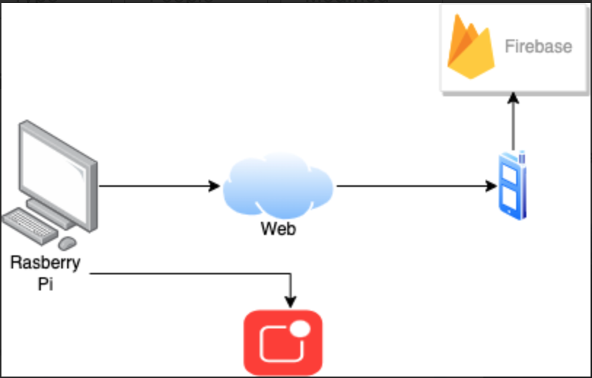
System Diagram

Slide 6
Project Requirements
HARDWARE
SOFTWARE
Motion detection
Livestream
Be able to stream to application
Be able to record and store footage
Face recognition
Audio customization
Voice functionality
Application to see livestream
Website
Enable user purchase
User manual
Setup page
Serialize devices
3

Slide 7
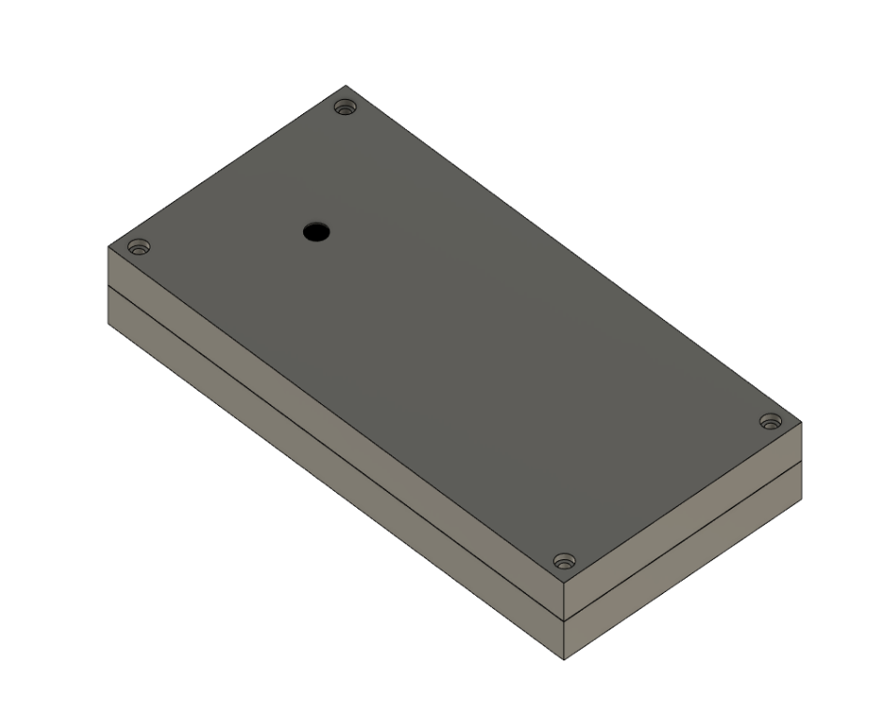
Accomplishments
CAD Box
User friendly mobile application
Motion detection capabilities
Livestream capabilities
One-way audio communication

Slide 8
Challenges
Summer Group produced a rushed product
Some of the hardware components/code was scrapped
Delay in hardware components
3D printing time constraints
Embedding the livestream and serialization of products

Slide 9
Conclusion
Hardware
Improved motion detection
One-way audio communication
3D printed case to hold hardware for a more presentable product
Software
Developed website to launch product
User Friendly mobile application
Future Goals
Push product to the public
Facial recognition
Notes:
Start from outside then narrow in

